Slide 1
SC1015 Mini Project
Personal key indicators of heart disease dataset
Fabian Tay, Thaddeus Chong, MUHAMMAD AKMAL BIN JOHARI
Notes:
Greetings, we are group 5 of lab group SC2 and it is my privilege of presenting our SC1015 Mini Project. I am Akmal, and together with Fabian and Thaddeus, we have come together to build our project based on the Personal Key Indicators of Heart Disease dataset which we have found from Kaggle.

Slide 2
Contents
Introduction
Exploratory Dataset
Machine Learning
Outcome
Notes:
These are the contents which I will be sharing in this presentation.

Slide 3

Introduction
Introduction
32% of global deaths
17.9 million lives
Heart disease is the leading cause of death globally
Source: World Health Organization
Notes:
Heart disease is the leading cause of death globally, taking an estimated 17.9 million lives each year, representing 32% of global deaths.

Slide 4

Introduction
Investigate and determine
Lifestyle habits or conditions
mostly contribute to one’s likelihood to suffer from heart disease
Power of data
Notes:
With the power of data, we get to investigate and determine what lifestyle habits or conditions that mostly contribute to one’s likelihood to suffer from heart disease.

Slide 5
How can different variables predict whether one has heart disease?
Problem Statement
Notes:
And with that, we have come up with our problem statement: How can different variables predict whether one has heart disease?

Slide 6
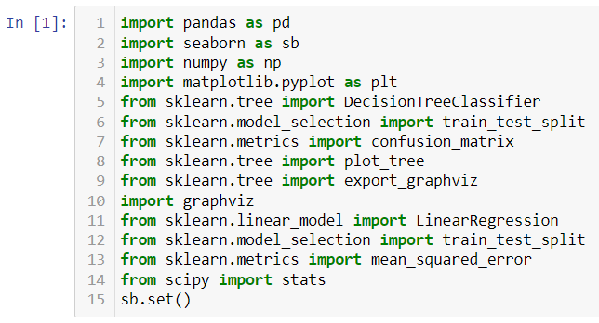
Libraries used
Notes:
Before we begin, we used the following libraries for our project; pandas for dataframes, seaborn, numpy, scipy and matplotlib for plotting graphs, scikit-learn and graphviz for machine learning. Now, let’s get into our project. Now, let us get into our project.

Slide 7
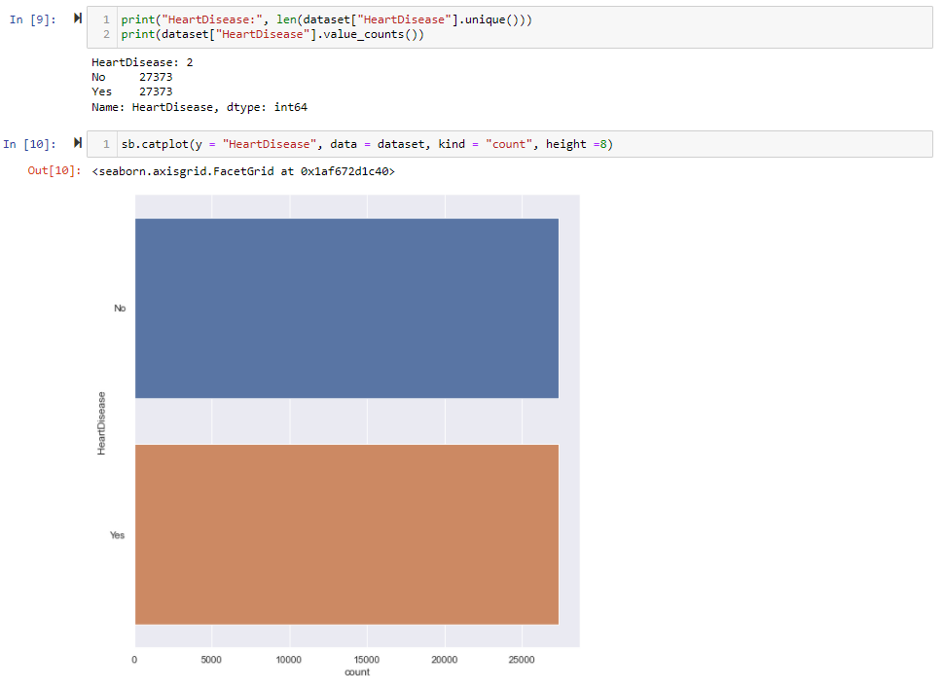
27373
has heart disease
27373
has no heart disease
Exploratory Dataset
319795
Notes:
From our dataset, there contains 319795 samples of which they are heavily skewed towards not having heart disease. So, using dataset.drop, we removed random samples that do not have heart disease such that we have 27373 samples of those who have heart disease as well as those who does not have heart disease each, bringing the total amount of samples to 54746.

Slide 8
Exploratory Dataset
BMI
Smoking
Alcohol Drinking
Stroke
Physical Health
Mental Health
Difficulty Walking
Sex
Age
Race
Diabetic
Physical Activity
General Health
Sleep Time
Asthma
Kidney Disease
Skin Cancer
17
Notes:
There are 17 different variables that are available in this dataset, but for the purpose of this video, we shall discuss 5 of them which are age, smoking, diabetic, general health and sleep time.

Slide 9
Exploratory Dataset
Age
Smoking
Diabetic
General Health
Sleep Time
5
Notes:
There are 17 different variables that are available in this dataset, but for the purpose of this video, we shall discuss 5 of them which are age, smoking, diabetic, general health and sleep time.

Slide 10
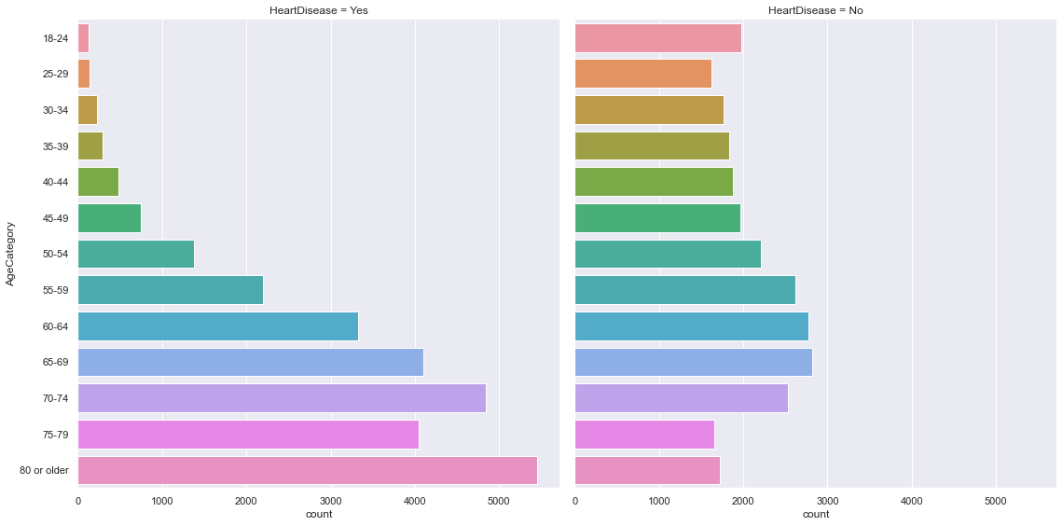
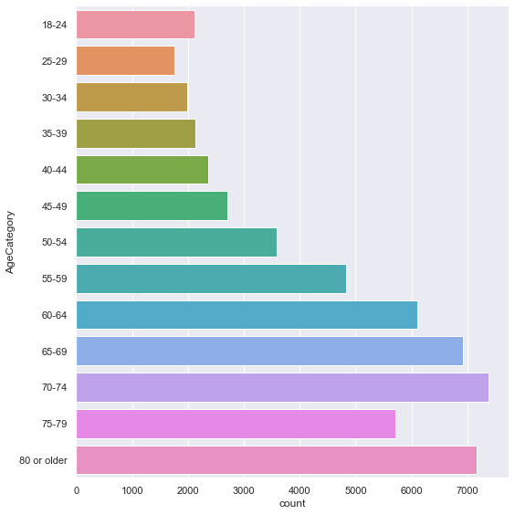
Exploratory Dataset
Age
Notes:
The first variable, age. In the dataset, the data are divided into 13 age groups with the count of each age group in this catplot. After which, we created two separate catplots based on whether they have heart disease or not. As you can see, we found out that heart disease has an increasing relationship with age as well as the majority of those who have heart disease belong to ages 50 and older.

Slide 11
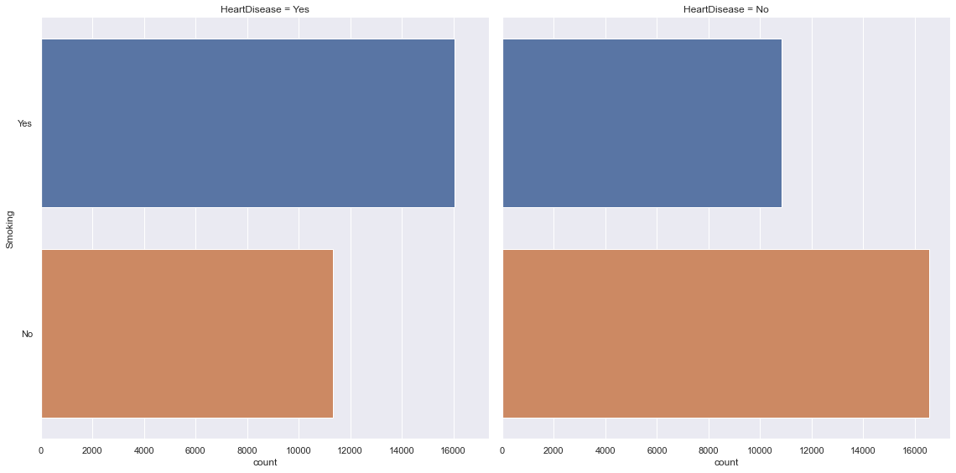
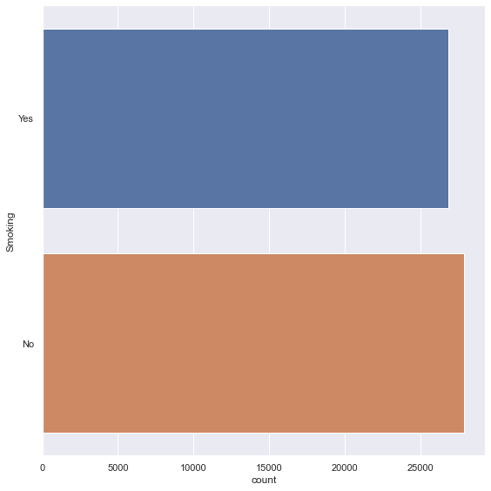
Exploratory Dataset
Smoking
Notes:
Next variable will be smoking. Using catplot, we found that this dataset has about the same number of smokers and non-smokers. And when we separate the data into whether they have heart disease or not, we got this graph. We can clearly see that there are a lot more smokers who suffer from heart disease compared to non-smokers.

Slide 12
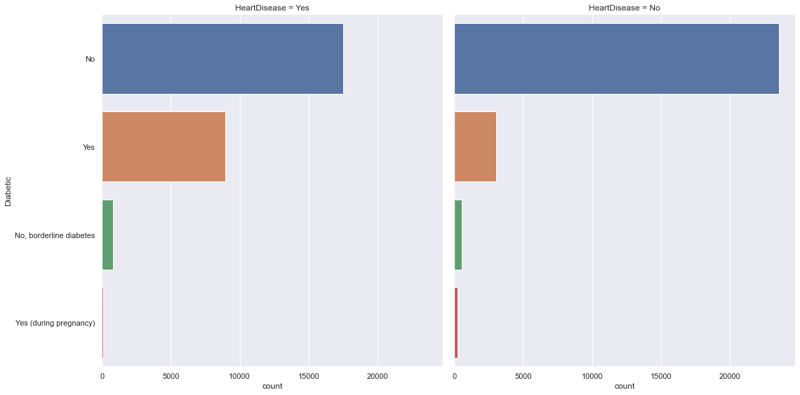
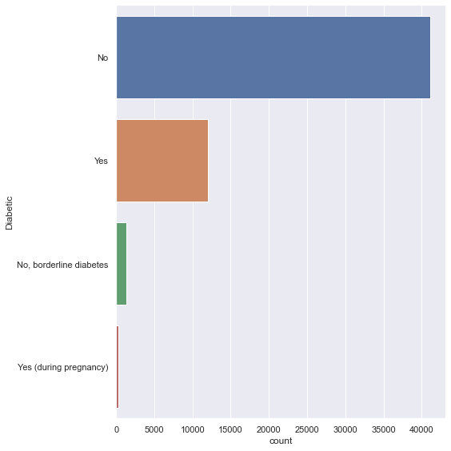
Exploratory Dataset
Diabetic
Notes:
We now move on to the third variable, diabetic. From our dataset, this is the distribution of the data from each category, with the most being non-diabetics. Now, for the distribution of the various categories under diabetic and whether they have heart disease or not, there are a lot more non-diabetics that do not suffer from heart disease than those who suffer from heart disease. An inverse of the relationship can be found for diabetics, where a lot more diabetics suffer from heart disease compared to those who don’t.

Slide 13
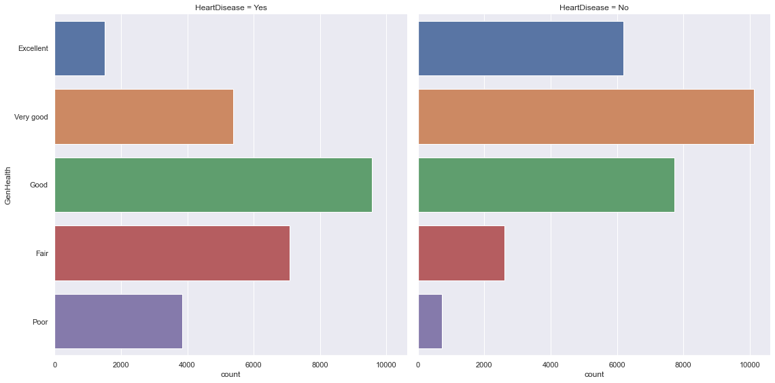
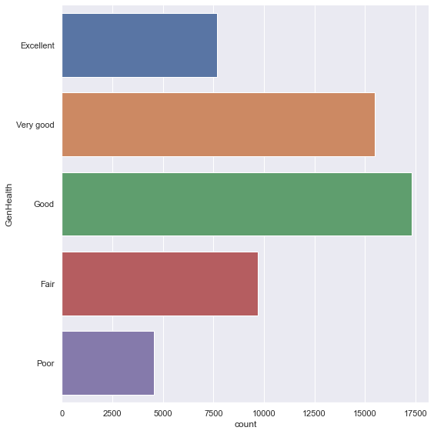
<
Exploratory Dataset
General Health
>
Notes:
Up next, general health. This variable seems more vague than others, as it depends on the person’s own assessment and perception of his or her current health state, on a scale from Poor to Excellent. Nevertheless, this is the distribution of the responses from the people in the dataset, resembling that of a normal distribution. When we looked at the separated catplots based on whether they have heart disease or not, we found that only ‘Excellent’ and ‘Very Good’ has less samples of not having heart disease whereas for ‘Good’, ‘Fair’ and ‘Poor’, there are more samples of having heart disease.

Slide 14
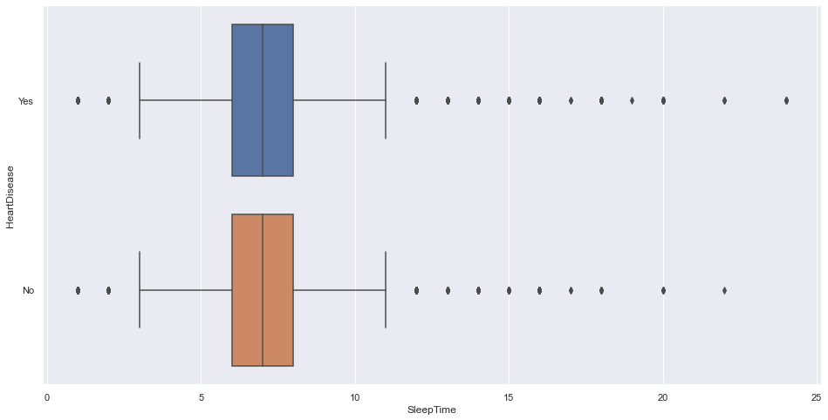
Exploratory Dataset
Sleep Time
Notes:
Last but not least, sleep time. We tried visualising the data through boxplot and found that since there is an overlap in the range of sleep time between heart disease sufferers and non-heart disease sufferers, it is not really a good predictor in determining the risk of suffering from heart disease. The data visualisation of all variables regardless of whether it is covered in this video can be found in the submitted code.

Slide 15
Response
Heart Disease: No
Heart Disease: Yes
Machine Learning
BMI
Smoking
Alcohol Drinking
Stroke
Physical Health
Mental Health
Difficulty Walking
Sex
Age
Race
Diabetic
Physical Activity
General Health
Sleep Time
Asthma
Kidney Disease
Skin Cancer
17
Predictors
Notes:
Now, we will be moving on to Machine Learning. So we will add all 17 variables as predictors into a multi-variate classification problem with the response variable being whether or not someone has heart disease.

Slide 16
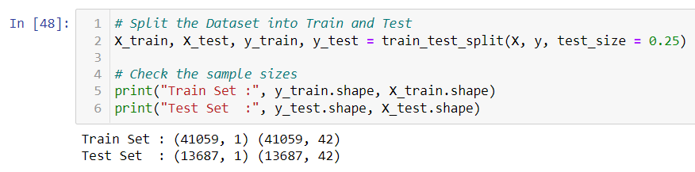
Machine Learning
Dataset
Train (75%)
Test (25%)
Notes:
To set up the classification problem, first we would need to split the dataset into two separate Train and Test datasets. We have set the train size to be 75% of the dataset and the test set to be 25% of the dataset using train_test_split.

Slide 17
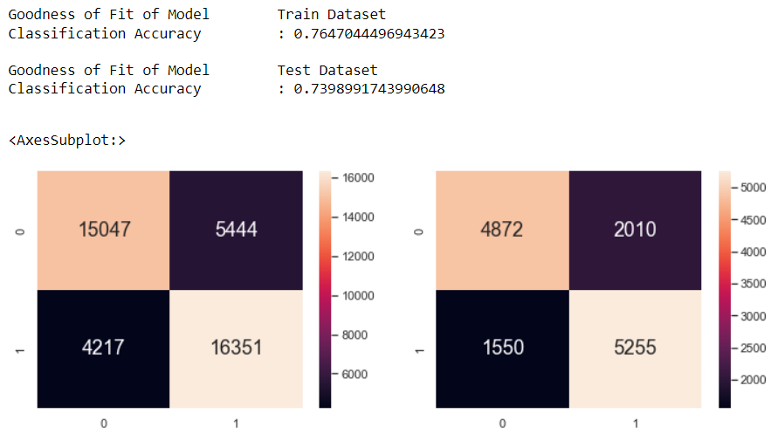
Machine Learning
Classification Tree
Notes:
Next up, we move on to creating the classification tree based on the train and test dataset. These are the returns from checking the goodness of fit of model as well as the confusion matrices of the train and test datasets. The decision tree can be seen through our code as it is too big to be included in this presentation.

Slide 18
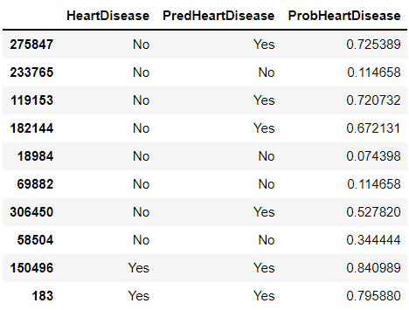
Machine Learning
Notes:
Now, to test our decision tree, we have chosen 10 random samples from the original dataset. The index from the dataset can be seen on leftmost column, followed by whether they actually have heart disease. Afterwards is our prediction whether they have heart disease and lastly the probability that is calculated based on our model. You can see that our model is not very effective in predicting the samples whether they have heart disease or not.

Slide 19
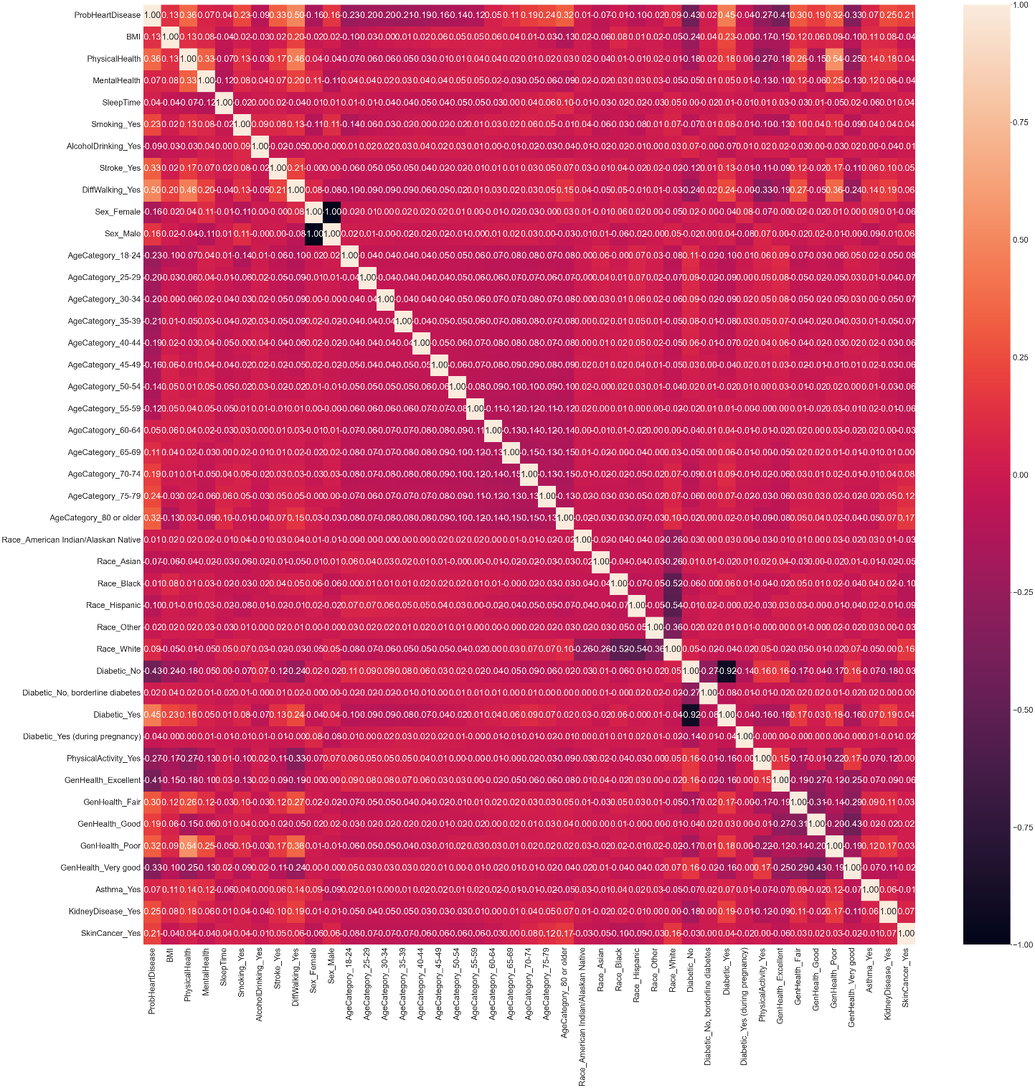
Machine Learning
Linear Regression
Notes:
So now, we are going to improve our model by using the linear regression model based on the probability from predictors. This is the correlation heatmap generated from the predictors and heart disease. From there, we generated the linear regression model based on the 17 predictors to determine the probability of a sample having heart disease.

Slide 20
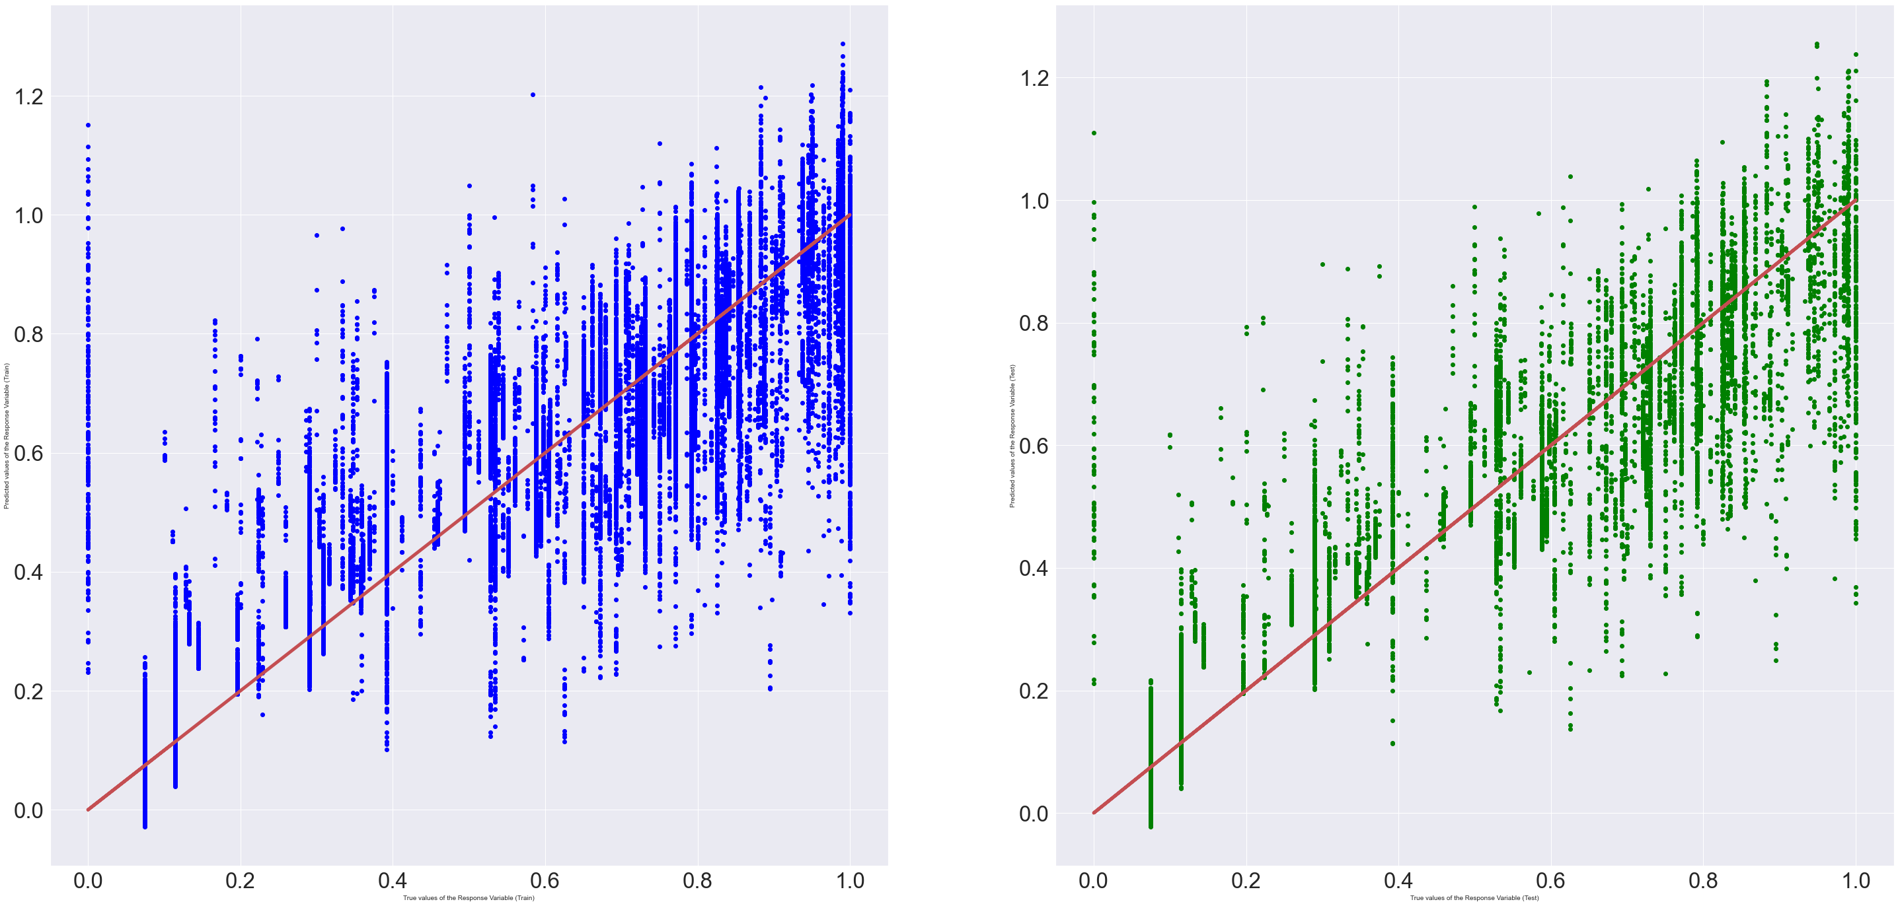
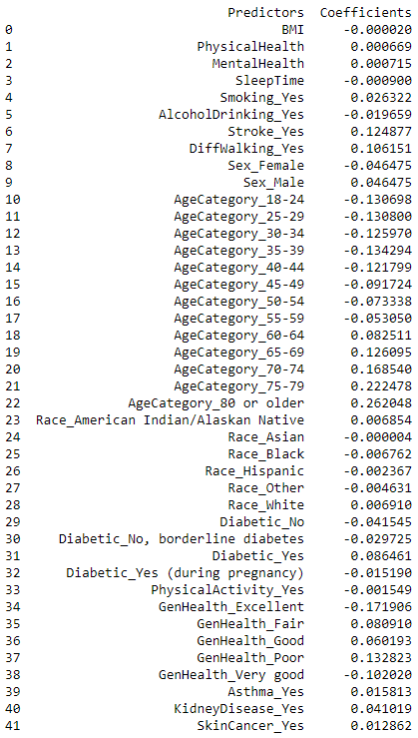
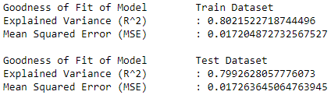
Machine Learning
Notes:
This is the coefficients that we have obtained from the predictors and the intercept of the regression in the linear regression model. This is the plotted graph which we have obtained from the train and test dataset as well as the goodness of fit of model for both the train and test dataset.

Slide 21
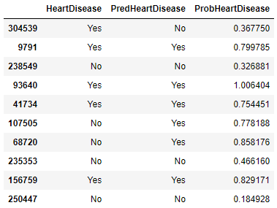
Machine Learning
Notes:
We then randomly picked another 10 samples from the original dataset to predict whether they have heart disease based on our new model. Although it is not perfect, it performed a bit better than the previous model.

Slide 22
Outcome
Although our model is not perfect, we get to know the groups of people that are more likely to have or develop heart disease.
For these groups of people, we can advise them to take healthier life choices to reduce the chances of them getting heart disease.
Linear Regression
+
Decision
Tree
Notes:
So, what have we learnt from this? We learnt that for our problem statement, the decision tree model alone is not enough to get a reliable prediction. So we require both linear regression and decision tree to have a model that can predict if someone is more likely to get heart disease. We also have found that although our model is not perfect, we get to know the group of people that are more likely to have or develop heart disease, such as people ages 50 and above. For these groups of people, we can advise them to take healthier life choices to reduce the chances of them getting heart disease, which, to reiterate, is the biggest cause of death currently.

Slide 23
References
Personal Key Indicators of Heart Disease. (2022, February 16). [Dataset]. https://www.kaggle.com/datasets/kamilpytlak/personal-key-indicators-of-heart-disease
Notes:
That is all we have for our presentation, Fabian took the role of doing the exploratory data analysis, Thaddeus took the role of using machine learning for the multi-variate problem and I took the role of preparing the presentation. We thank you for your time.

